Slide 1
Random (Stochastic) Processes
A collection of random variables indexed by time
Instead of “time”, one can have “space”, or another index
Time can be continuous (e.g., real numbers), or discrete (e.g., integers)
Stock market, noise in a receiver, arrival times of customers etc…
With a RV, an experiment produces a single number, “realization”
With a random process, a single experiment produces
Function of time (stock market example)
A sequence of points (real numbers) in time (arrival times example)
An array of colors (real numbers) (a random picture)
To give you a flavor, we will briefly study simple examples of
Gaussian random processes
Point processes (that model arrival times)
Markov chains (a finite state machine with randomly evolving states)

Slide 2
Random Processes Applications
Applications
Finance (evolution of prices with time)
Communication theory (rec. noise modeling and analysis)
Signal processing (find hidden periodicities in random data)
Queuing theory (supermarkets, data networks)
Biometrics (e.g. birth-death processes)
…etc…

Slide 3


Random Processes Examples
White Gaussian random process
A Gaussian RV for each t (assume for convenience discrete)
Each sample has the same distribution (Gaussian with same param.)
Independent RVs for different t, no matter how many samples
E.g. are independent RVs
This is an example of a “stationary” process
The joint distribution of a collection of RVs obtained by sampling
in time, does not depend on the time index but on relative location
sampling times

Slide 4
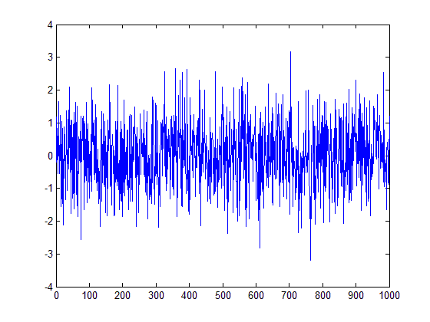
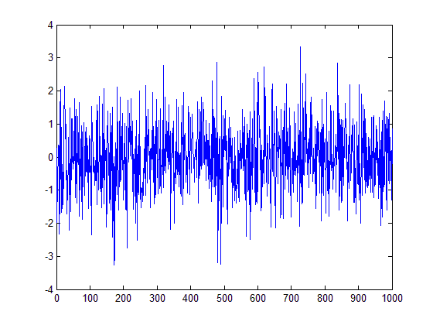
Pictures of Realizations
“Plots” of RPs are not possible, only realizations
Continuous vs discrete
Stationary vs nonstationary
Independent across time vs dependent
Two examples of “white noise” (independent)
plot(wgn(1000,1,0))

Slide 5
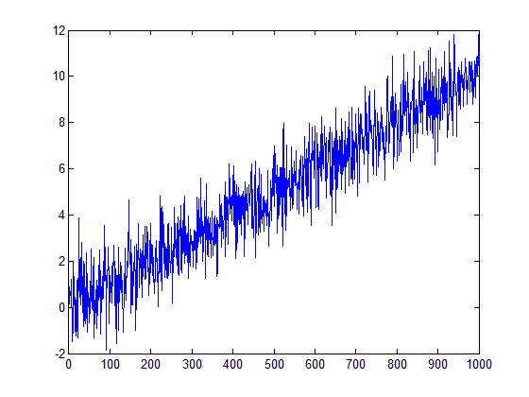
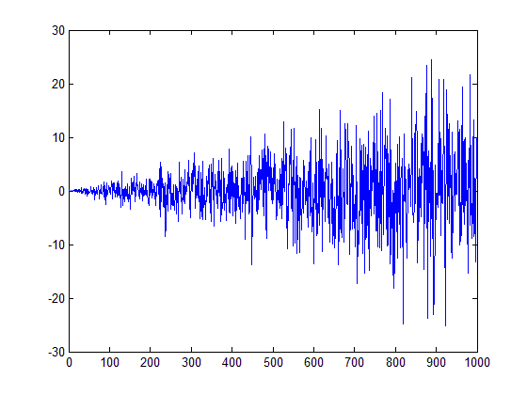
Pictures (nonstationary)
Why are these nonstationary?

Slide 6
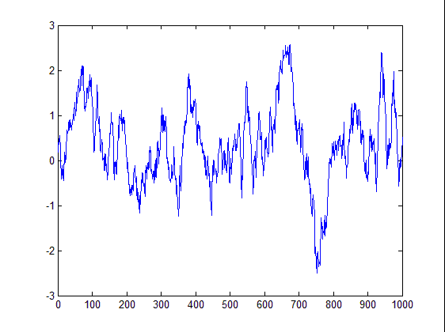
Pictures (white vs filtered noise)
“Plots” of RPs are not possible, only realizations
Compare “white noise” with a “colored” case
They are both Gaussian
plot(filter((1/sqrt(50))*ones(1,50),1,wgn(1000,1,0)))

Slide 7
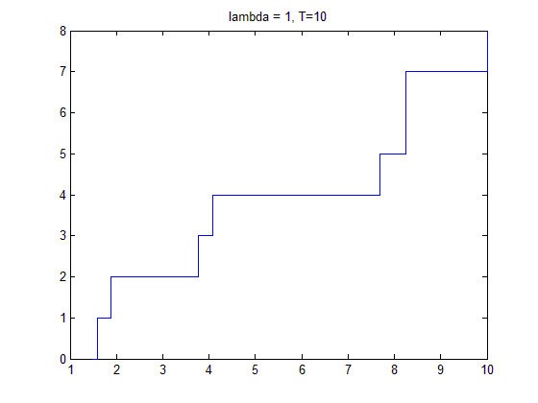
Pictures (Poisson)
Poisson Process
Interarrival times are exponential
Plot increases by 1 at each “point”
# of points in any interval is Poisson with param
prop to length of interval

Slide 8
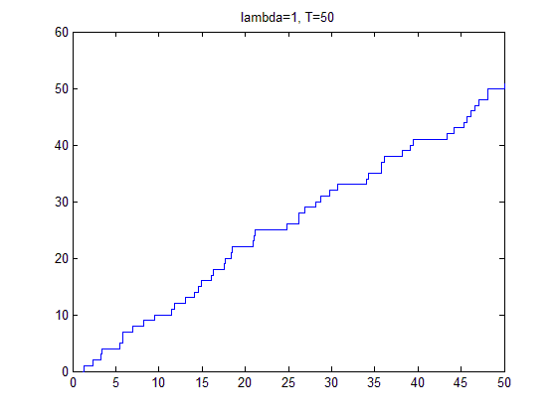
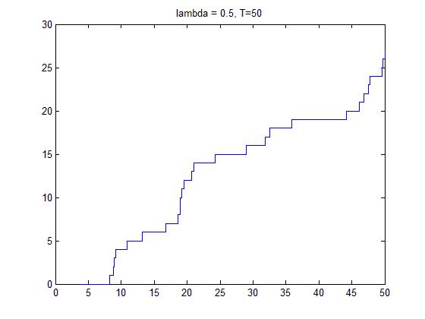
Pictures (different parameters)
Poisson Process different lambda
More “Poisson points” per fixed interval on left

Slide 9
Markov Chains
Models random state transitions
An “outcome” is a sequence of states
Simple model for capturing time-dependence
Example: Consider two communication models
In model 1, we have one probability for toggling probability
In this model 1, each bit of a bit string gets toggled indep.
In practice we have “burst errors”
In model 2, we have a “good” and a “bad” toggling probability
Consider the case of being small
If we are in “good times”, we remain in “good times” and vice versa
P_{GB}
P_{BG}
P_{GB}
P
1-P_{GB}
G
B
1-P_{BG}
P_{BG}

Slide 10
Acknowledgements and Citations
Parts of these slides are adapted from the following resources:
Power Point Lecture Slides for the Textbook http://bcs.wiley.com/hebcs/Books?action=index&bcsId=8676&itemId=1118324560
John Tsitsiklis. 6.041 Probabilistic Systems Analysis and Applied Probability, Fall 2010. (Massachusetts Institute of Technology: MIT OpenCourseWare),http://ocw.mit.edu (Accessed 13 Apr, 2015). License: Creative Commons BY-NC-SA

